Slide 1



UNIVERSITY INSTITUTE OF ENGINEERING
COMPUTER SCIENCE ENGINEERING
Bachelor of Engineering
Cloud Computing(CST-411)
Prepared By: Ms. Himanshu(E11818)
Topic: Virtualization
DISCOVER . LEARN . EMPOWER

Slide 2
Learning Objectives & Outcomes
Objective:
To understand the concept of Virtualization
Outcome:
Student will understand
Virtualization
Its Working

Slide 3
Overview
What is Virtualization?
What is a Virtual Machine?
How Virtualization works?
Advantages of Virtualization
Features of virtualization

Slide 4

Virtualization

Slide 5
What is Virtualization ?
Virtualization is a Technology that transforms hardware into software.
Virtualization allows to run multiple operating systems as virtual machines.
Each copy of an operating system is installed in to a virtual machine.
It allows the virtual system to access the resources of the primary system such as RAM, ROM, Storage, CPU, Network etc.

Slide 6
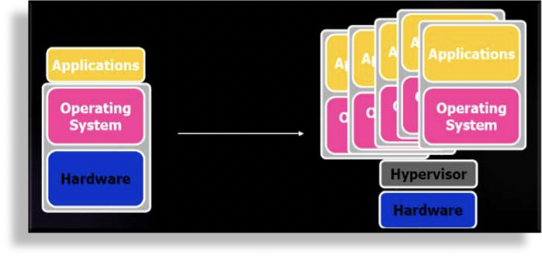
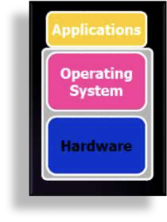
Normal Computer System
Virtualized Computer System

Slide 7
What is a Virtual Machine?
Isolated guest operating system installation within a normal host operating system.
From the user perspective, virtual machine is software platform like physical computer that runs operating systems and apps.
Virtual machines posses hardware virtually.

Slide 8
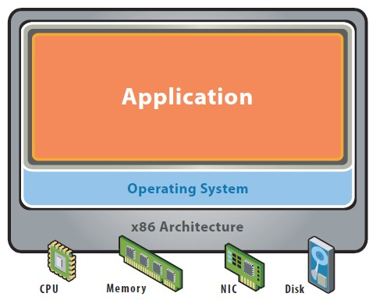
Before Virtualization
Single OS image per machine
Software and hardware tightly coupled
Running multiple applications on same machine often creates conflict
Inflexible and costly infrastructure

Slide 9
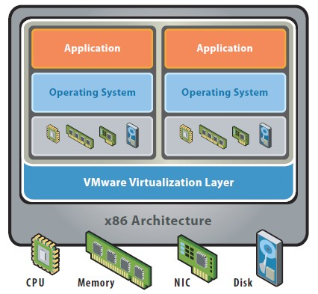
After Virtualization
Hardware-independence of operating system and applications
Virtual machines can be provisioned to any system
Can manage OS and application as a single unit by encapsulating them into virtual Machines

Slide 10
Advantages of Virtualization
The number of servers gets reduced by the use of the virtualization concept.
Improve the ability of technology.
The business continuity was also raised due to the use of virtualization.
It creates a mixed virtual environment.
Increase efficiency for the development and test environment.
Lowers Total Cost of Ownership (TCO).

Slide 11
Features of Virtualization
Partitioning: Multiple virtual servers can run on a physical server at the same time.
Encapsulation of data: All data on the virtual server, including boot disks, is encapsulated in a file format.
Isolation: The Virtual server running on the physical server is safely separated and don't affect each other.
Hardware Independence: When the virtual server runs, it can migrate to a different hardware platform.

Slide 12
References
Text books:
Buyya, Rajkumar, James Broberg, and Andrzej M. Goscinski, eds. Cloud computing: Principles and paradigms. Vol. 87. John Wiley & Sons, 2010.
Miller, Michael. Cloud computing: Web-based applications that change the way you work and collaborate online. Que publishing, 2008
Websites:
https://www.ibm.com/cloud/learn/virtualization-a-complete-guide
https://data-flair.training/blogs/virtualization-in-cloud-computing/
https://www.w3schools.in/cloud-computing/cloud-virtualization/

Slide 13
THANK YOU

